Slide 1
Ministry of Science and Higher Education of the Russian Federation ITMO University School of Translational Information Technologies
Field of study «01.04.02 Applied Mathematics and Informatics»
Profile: Bioinformatics and Systems Biology 2023
Course Homework1 of «Applied Statistics. ITMO. Spring 2024»
“Trees on Barro Colorado”
Student of Group №: M4135, Institute of Applied Computer Science
Wong Pei Fong (Вон Пэй Фон)
Lecturer:
Lavrentii Danilov
Saint-Petersburg, 21.03.2024

Slide 2
Description
Data give the numbers of trees at least 10 cm in diameter at breast height (1.3 m above the ground) in each one hectare square of forest. Within each one hectare square, all individuals of all species were tallied and are recorded in this table.
The data frame contains only the Barro Colorado Island subset of the original data.
The quadrats are located in a regular grid. See BCI.env for the coordinates.
A full description of the site information in BCI.env is given in Pyke et al. (2001) and Harms et al. (2001). N.B. Pyke et al. (2001) and Harms et al. (2001) give conflicting information about forest age categories and elevation.

Slide 3
Purpose
1. Make EDA for data.
2. Build an ordination of objects (descriptions, samples, etc.).
3. Visualise the relationship between the resulting ordination and environmental parameters.
4. Draw conclusions about the most important factors.

Slide 4
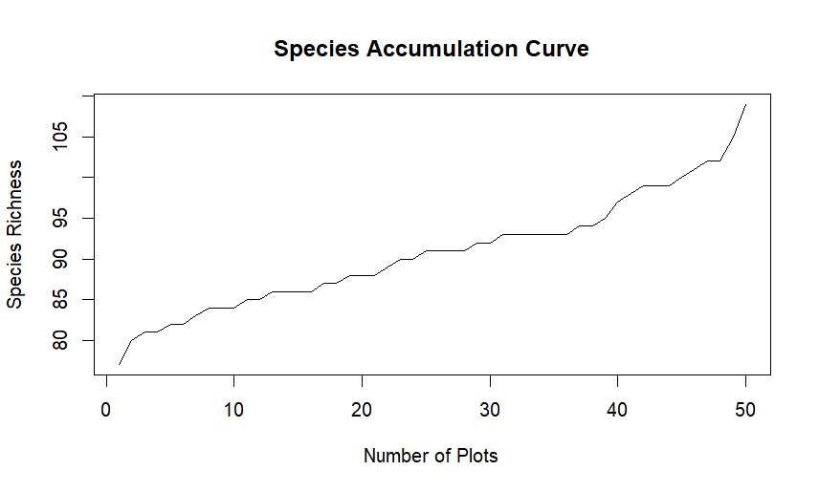
1. Plot species accumulation curve

Slide 5
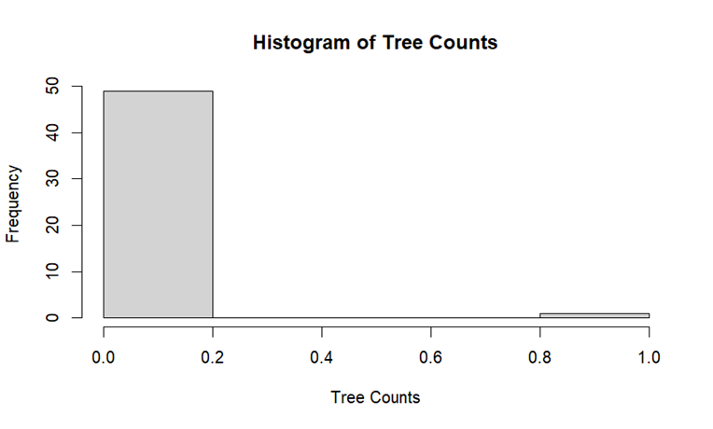
1. Plot histogram of tree counts for the first species in the dataset

Slide 6
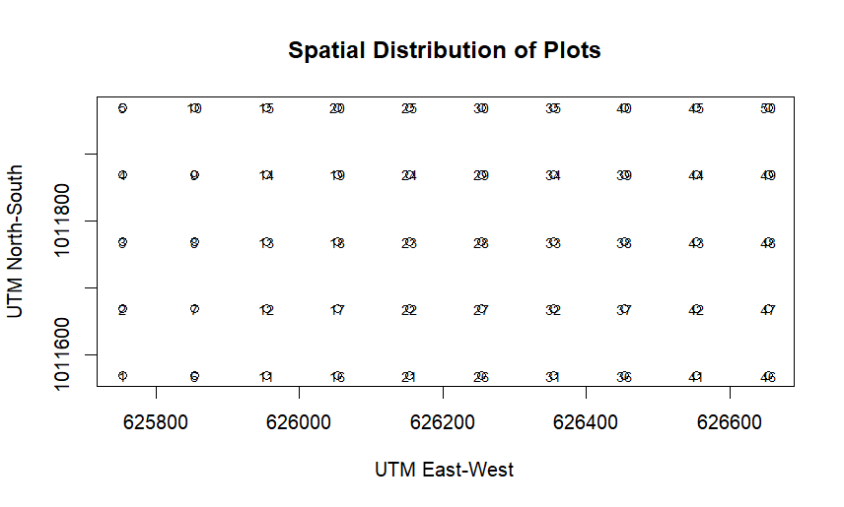
1. Spatial distribution

Slide 7
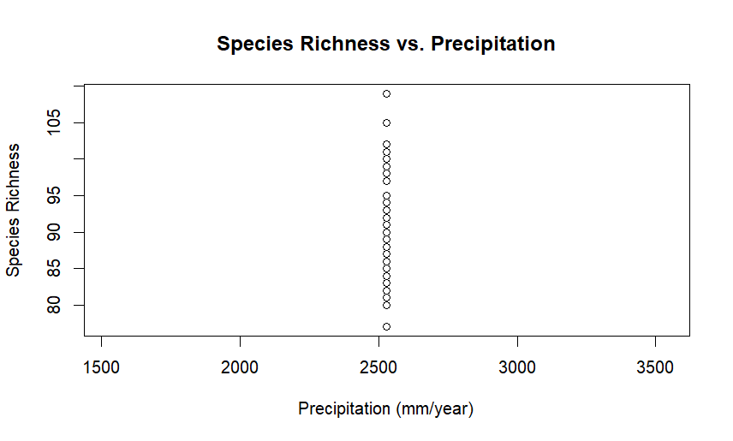
1. Plot tree counts against precipitation

Slide 8
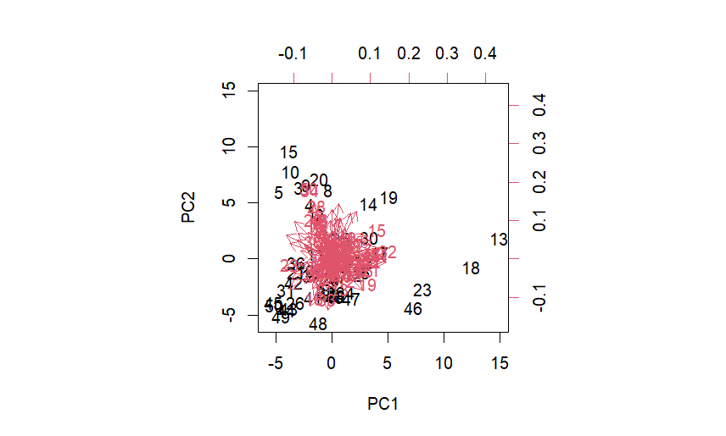
2. Biplot of PCA

Slide 9
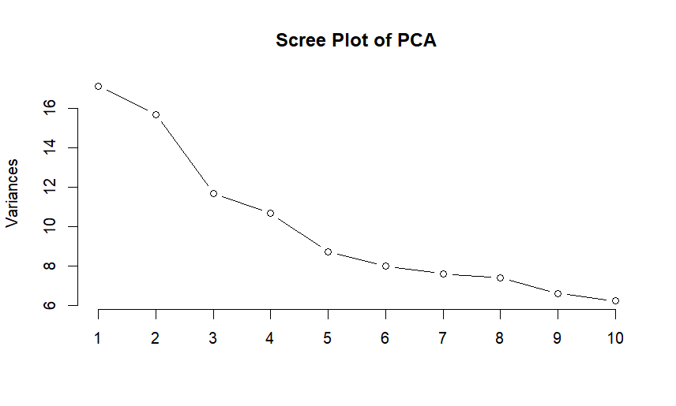
2. Scree Plot of PCA

Slide 10
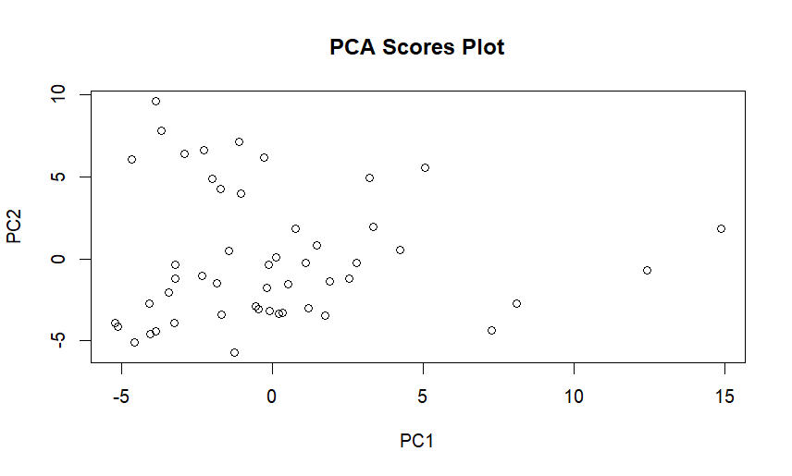
2. PCA scores

Slide 11
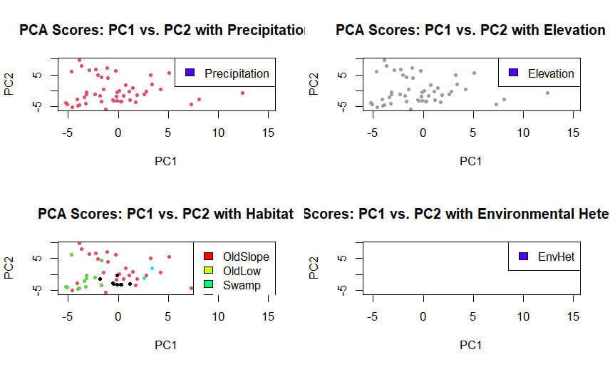
3. Plotting PCA scores with environmental parameters

Slide 12
4. Conclusions about the most important factors
Precipitation: there is a gradient of precipitation values across the plots
Elevation: elevation also influences the distribution of species.
Habitat: different habitat types exhibit distinct patterns in the ordination space.
Environmental Heterogeneity: Plots with higher environmental heterogeneity tend to show greater dispersion in the ordination space, indicating a wider range of species compositions.

